Slide 1
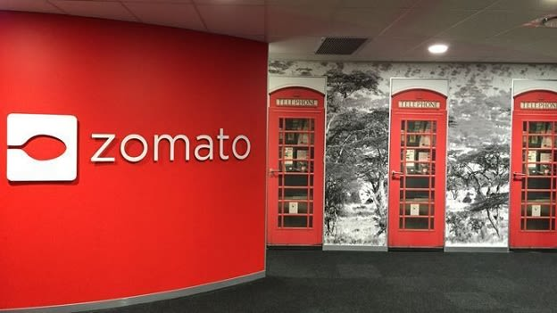
Zomato Restaurant Analysis Aniket Trivedi 13/03/2024

Slide 2

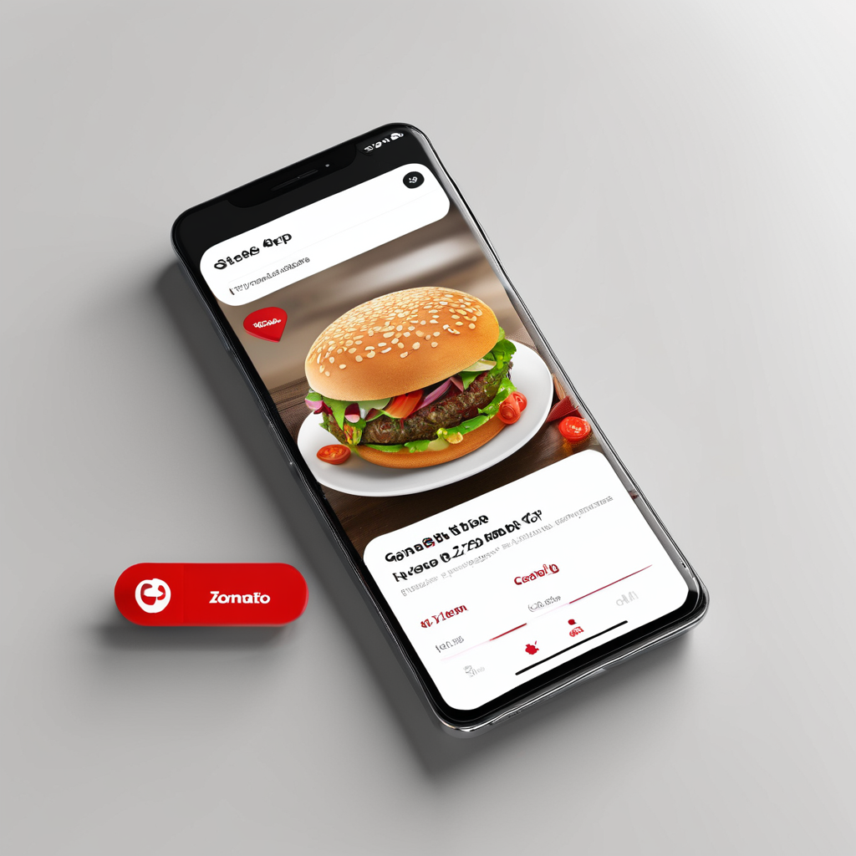
Introduction to Zomato
History
Zomato was founded in 2008 as a restaurant discovery platform in India. It started as a website that provided information about restaurants, including menus, reviews, and ratings.
Mission
Zomato's mission is to ensure that everyone can find and enjoy great food. They aim to connect users with the best dining experiences by providing accurate and comprehensive information about restaurants.
User Base
Zomato has a large and diverse user base, with millions of active users worldwide. It is available in multiple countries and supports multiple languages, making it accessible to a global audience.

Slide 3
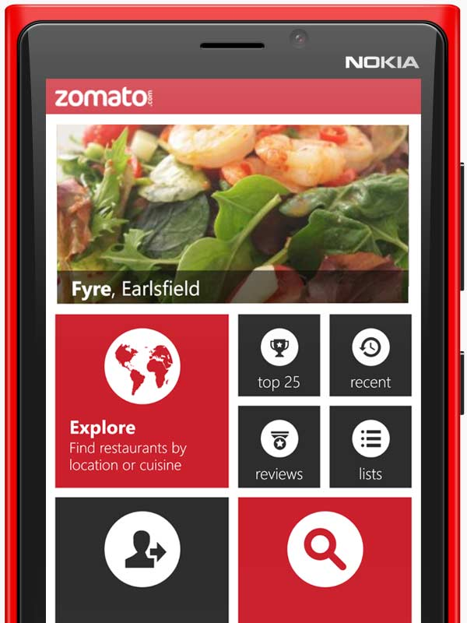
Project Aim
The objective of the project is to analyze the Zomato market scenario based on given dataset and provide meaningful insights, to help in the business growth.

Slide 4
Data Overview
Restaurant ID: Unique identifier for each restaurant.
Restaurant Name: The name of the restaurant.
CountryCode: Country code of the location where the restaurant is situated.
City: The city where the restaurant is located.
Address: The specific address of the restaurant.
Locality: The locality or neighborhood where the restaurant is situated.
Locality Verbose: Detailed information about the locality.
Longitude: The geographical longitude coordinate of the restaurant.
Latitude: The geographical latitude coordinate of the restaurant.
Cuisines: The type of cuisine offered by the restaurant.
Currency: The currency used for transactions in the restaurant.
Has_Table_booking: Indicates whether the restaurant has a table booking option (Yes/No).
Has_Online_delivery: Indicates whether the restaurant offers online delivery (Yes/No).
Is_delivering_now: Indicates whether the restaurant is currently delivering (Yes/No).
Switch_to_order_menu: Indicates whether users can switch to the order menu (Yes/No).
Price_range: A numeric value indicating the price range category of the restaurant.
Votes: The number of votes or ratings/(feedback) received by the restaurant.
Average_Cost_for_two: The average cost for two people dining at the restaurant.
Rating: The overall rating of the restaurant is based on user reviews.
Datekey_opening: The date when the restaurant was opened.

Slide 5

Data Cleaning and Processing
Build an dynamic table which will be connected to the Raw Data so that any changes made in the original data by company will get reflected in the dynamic table as well as in the Dashboard.
Treated the missing values of cuisines from USA.
Calculated the total number of restaurants per country.
Processed different currencies and converted into INR (for comparisons).
Used appropriate LOOKUP functions to fetch the country code.

Slide 6

Methodology
Missing value treatment:- Using power query editor, pivot table, XLOOKUP functions, MAX function.
Data Enrichment:- Enhanced the data set with additional variables using VLOOKUP, MID, SEARCH, TRUNC, CONCAT, and connecting tables to cross reference with original data source.
Descriptive Analysis:- Employed Pivot tables for summarizing key metrices, conditional aggregational functions and normal excel functions (count, if, etc.) for analyzing objective questions.
Trend Analysis:- Analyzed the trend between feedbacks/ratings, cuisine prices, online delivery and table booking, using sparkline, scatter plots and trendlines.
Executive Segmentations:- Applied year and country wise filters to analyse the various outcomes of ratings, prices etc. for different countries at a different timeline.
Data Visualization:- Created dynamic charts and Dashboard for data representation, enabling interactive data exploration.

Slide 7
Analysis of Objective Questions
The number of restaurants opened in each country
Chart displays the number of restaurants in each country of the dataset.
India is having the highest number of restaurants i.e. 8652
Second place is occupied by USA with 434 restaurants.
Canada is at the last of the graph indicating least number of restaurants i.e. 4

Slide 8
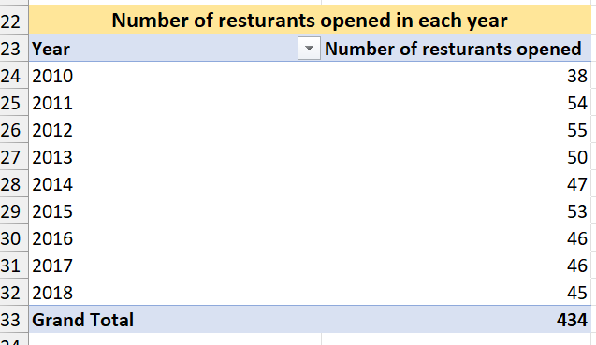
The number of restaurants opened each year
Highest number of restaurant was open in year 2012, following with 2011, 2013.
After 2015 we can se a drop in 3yrs constantly

Slide 9
The average number of voters for the restaurants in each country
Indonesia is having the highest number of voters in restaurants, followed by UAE, USA AND Philippines.
As compare to number of restaurants in India, the number of voters are very less.

Slide 10
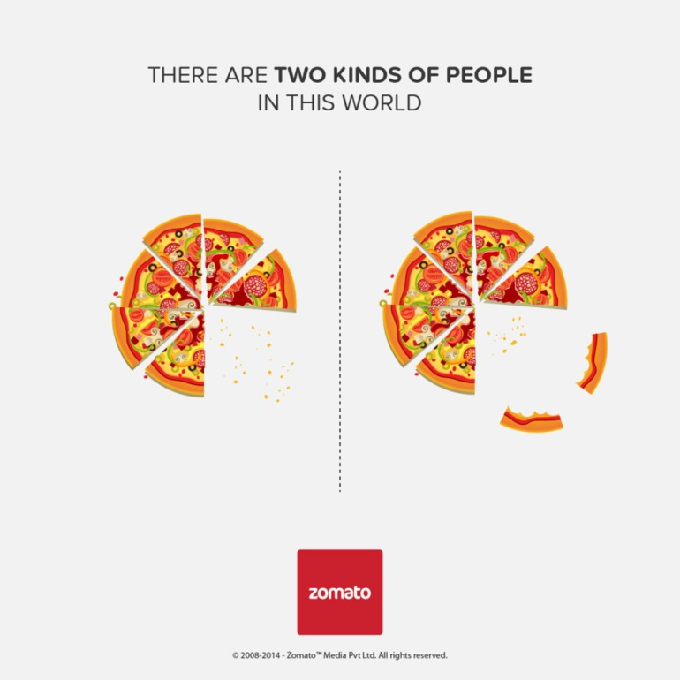
There is 1 table present in the data.
The total no. of attributes present in the data are 21.
There are 15 categorical columns in the data.
Total number of restaurants around the world is 9551.
Dataset contains data from 15 different countries across the world.
There are 388 restaurants in India in the price range of 4.
The average rating for all the restaurants that have price range is less than 4 and provide online delivery is 3.27
There are 1811 number of restaurants listed that do not offer online delivery, are in the lowest price range, and have an average cost for two people less than or equal to 250 Indian Rupees.

Slide 11
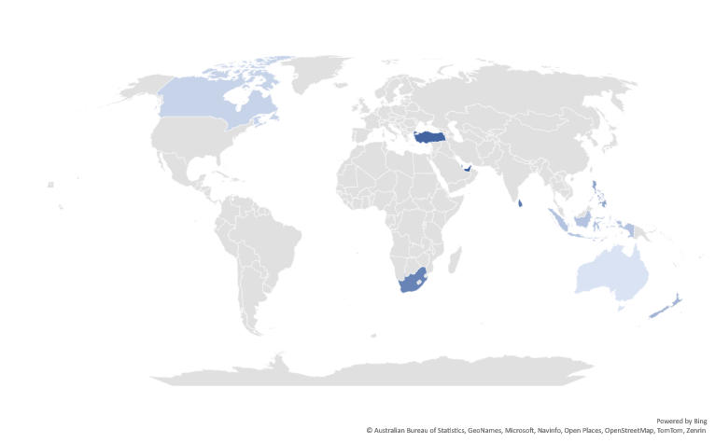
Subjective Questions Analyses
Most suitable countries (cities) for opening new restaurants based on criteria where total number of restaurants are less than 200, average ratings are higher than or equals to 3, with less than Rs 1600 average expenditure for two person to have a meal and number of voters higher than 150, are :
Australia (Beechworth, Hepburn Springs, Phillip Island), Canada (Chatham-Kent), Indonesia (Bogor, Jakarta), New Zealand (Auckland, Wellington City), Philippines (Mandaluyong City, Pasig City, Quezon City, San Juan City), Qatar (Doha), South Africa (Cape Town, Johannesburg, Pretoria, Randburg, Sandton), Sri Lanka (Colombo), Turkey (Ankara, Istanbul), UAE (Abu Dhabi, Sharjah)

Slide 12
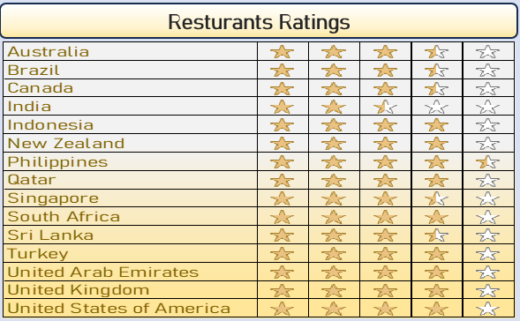
The current quality regarding ratings for restaurants that are open there.
Using conditional formatting feature of Excel to calculate the average rating in all countries.

Slide 13
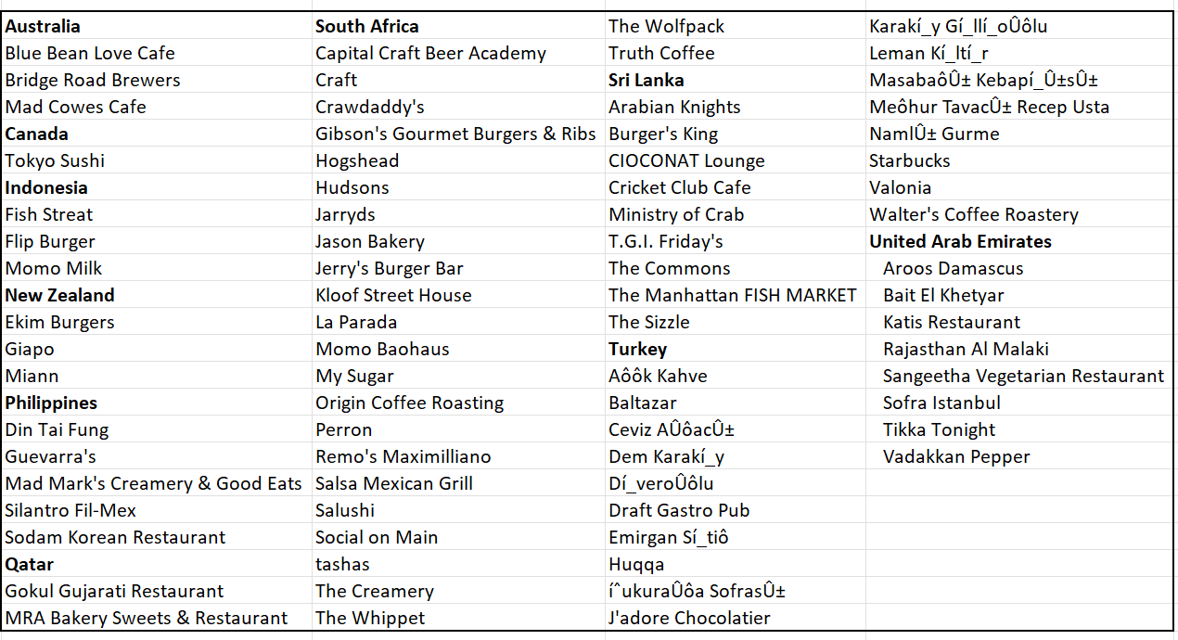
Names of restaurants from the recommended states that are our biggest competitors.
Biggest Competitors criteria: -
Restaurant rating>=3
avg_cost_for_two< Rs 1600
Number of Voters > 150

Slide 14
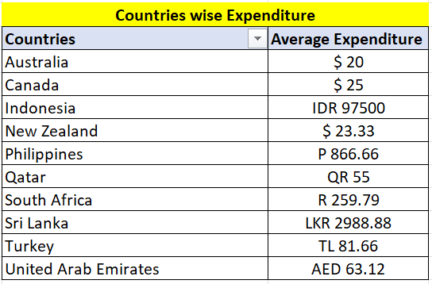

The current expenditure on food in the suggested countries.
Using Pivot table and CONCAT function to calculate the average expenditure for each country.

Slide 15
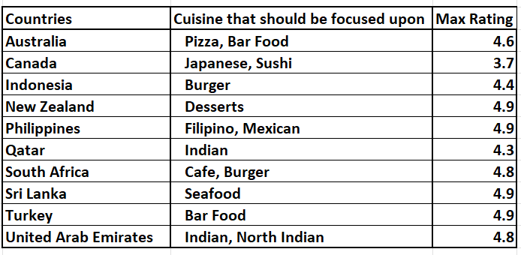
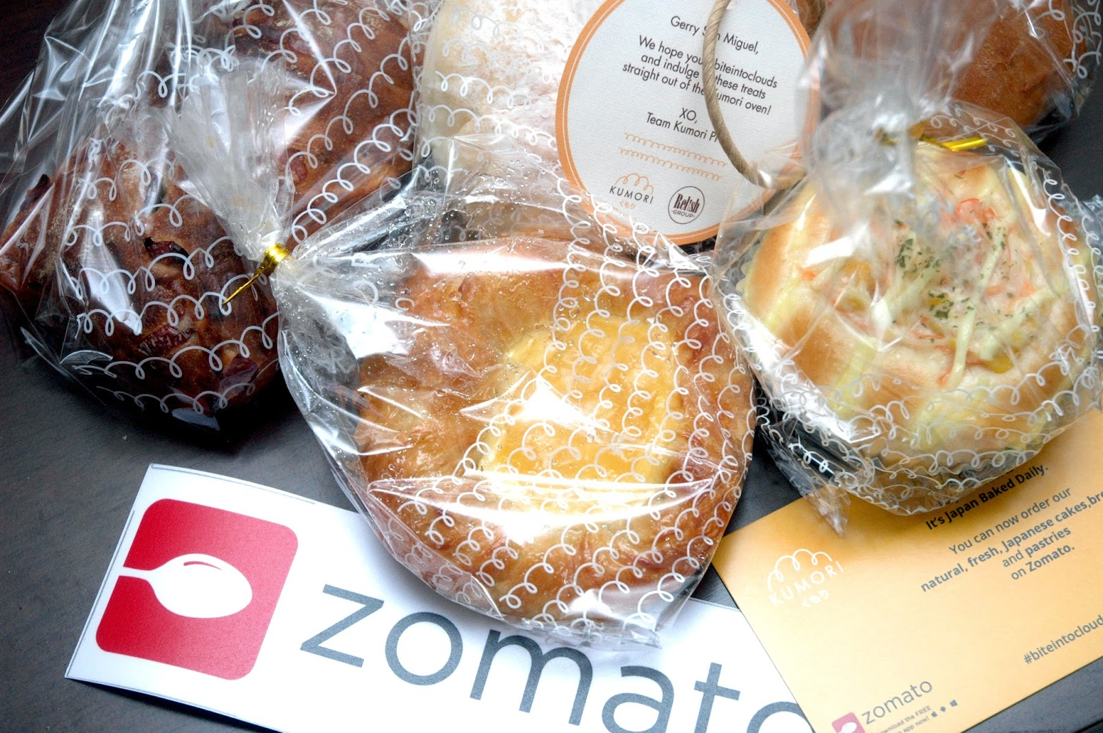
Cuisines should we focus on in the newer restaurants to get better feedback
Cuisines with good ratings i.e. those cuisines which are already performing well in the countries can be introduced in new restaurants branches to generate good amount of revenue at the start. After that we can introduce the local cuisines also according to the future demands by customers.

Slide 16
Does online delivery and table booking affects the customer’s ratings?
Insights: - Those restaurants which are having online delivery and table booking both are showing an increase in ratings. Therefore, we can say that online delivery and table booking does affects the customer’s ratings.
Recommendations: - Include features of online delivery and table booking for the ease of customer.
Should the team keep the rate of cuisines higher? Will that affect the feedback?
Insights: - As the linear forecast trendline is moving slightly upward direction and the correlation coefficient is moving towards +1, therefore, we can say that the rates of cuisines and ratings are positively correlated i.e as one variable increases, the other tends to also increase.

Slide 17
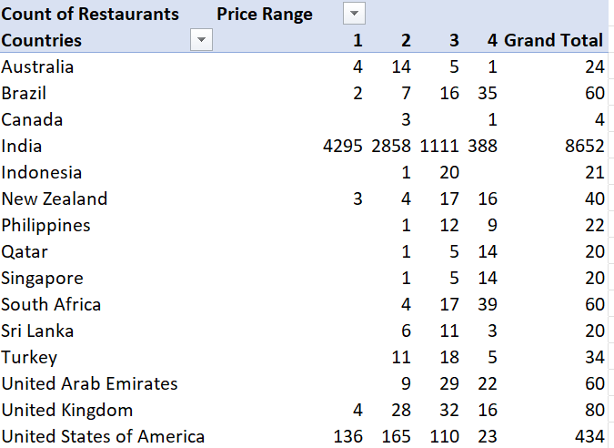
Recommendation: - Seeing the insights doesn’t mean we should increase the price of every cuisine in every country to get better ratings. We should also look the country wise scatter plot for the rating and average price, and increase the rate where the country allows to do so.
The distribution of the number of restaurants of different price ranges in all the countries.

Slide 18
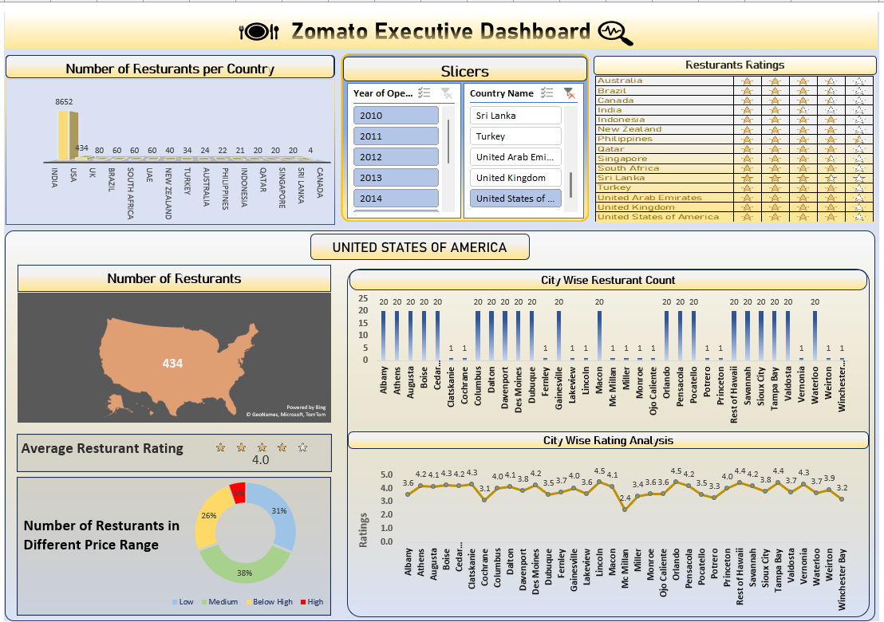
DASHBOARD

Slide 19
Conclusion
In conclusion, our analysis of Zomato restaurant data reveals promising opportunities for strategic expansion across the globe. By targeting regions with high demand, catering to specific demographic preferences, and capitalizing on competitive advantages, we can confidently recommend the opening of new restaurants. This initiative not only enhances market presence but also delivers exceptional dining experiences, driving sustainable growth for Zomato and enriching the global culinary landscape.

